Slide 1

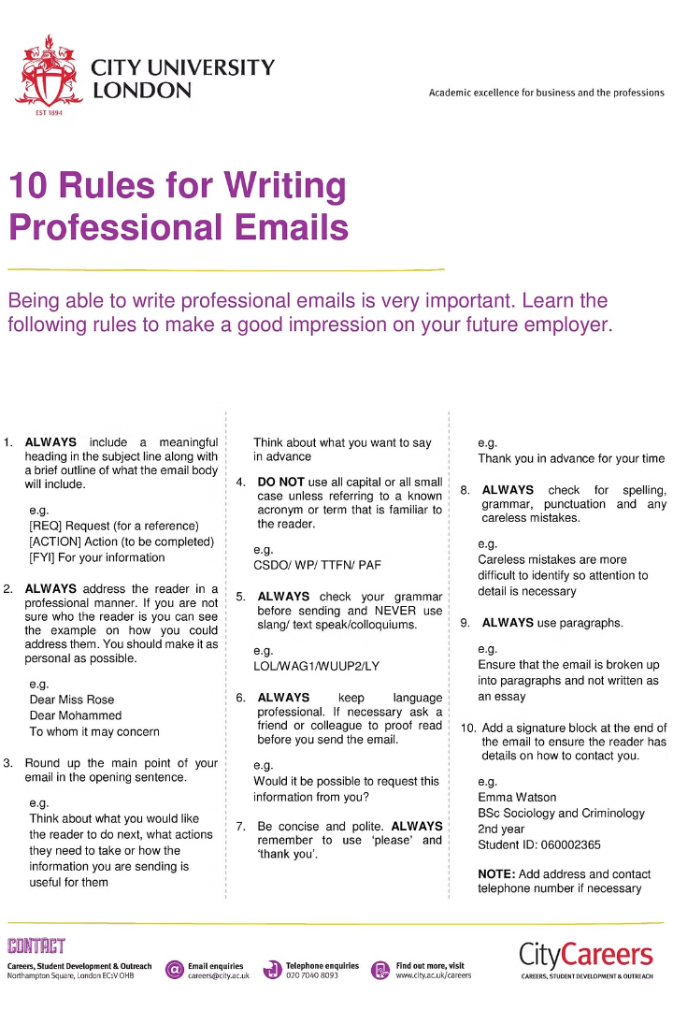
Email Etiquette and Formal Letter Writing
Effective communication is key in the modern business world. This workshop will cover the essential elements of email etiquette and provide guidance on crafting compelling formal letters that make a lasting impression.
by Dinara Naimanova,
M.Ed., senior lecturer of the Primary Education Department,
Faculty of Pedagogy and Psychology, Abai Kazakh National Pedagogical University.
Kazakhstan

Slide 2

Importance of Professional Communication
1
Builds Trust
2
Enhances Productivity
3
Presents a Polished Image
Well-written emails and letters establish credibility and foster positive relationships with colleagues, clients, and partners.
Clear, concise communication streamlines workflows and minimizes confusion or delays.
Adhering to etiquette standards projects an image of professionalism and competence.

Slide 3
Elements of Effective Email Structure
Subject Line
Greeting
Body
A clear, specific subject line helps the recipient quickly understand the email's purpose.
Begin with a professional salutation using the recipient's name and title.
Organize the content into concise paragraphs with a logical flow.

Slide 4
Crafting a Compelling Subject Line
Be Specific
Keep it Concise
Clearly communicate the email's focus or request in the subject line.
Aim for 5-7 words that convey the main idea.
Avoid Fluff
Personalize
Skip unnecessary words and get straight to the point.
Use the recipient's name or reference a previous conversation.

Slide 5




Tone and Language in Formal Correspondence
Professional
Clear
Polite
Concise
Use a courteous, respectful tone free of informality or slang.
Communicate your message directly and avoid ambiguity.
Express gratitude, apologies, or requests in a considerate manner.
Be succinct, eliminating unnecessary words or filler.

Slide 6

Interactive Activity: Email Etiquette Scenarios
Scenario 1
Scenario 3
You need to request an extension on a project deadline from your manager.
You need to follow up with a coworker who has not responded to your previous email.
1
2
3
Scenario 2
A client has emailed you with a complex question about a recent order.

Slide 7
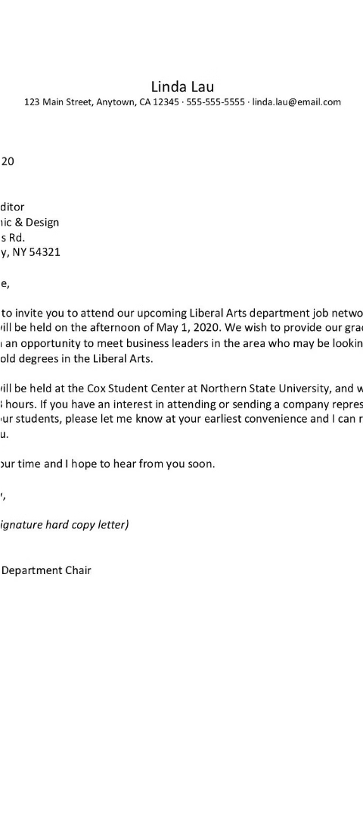



Best Practices for Formal Letter Writing
Opening
Begin with a clear, courteous greeting and state the purpose upfront.
Body
Provide relevant details and background information in a logical flow.
Closing
Conclude with a call-to-action or restate the next steps.

Slide 8
Conclusion and Key Takeaways
Maintain Professionalism
Adhere to etiquette standards to build trust and credibility.
Communicate Clearly
Use concise, unambiguous language to streamline workflows.
Pay Attention to Detail
Crafting compelling subject lines and letter structures leaves a lasting impression.

Slide 9
Literature:
Dürscheid C. et al. Email communication //Handbooks of Pragmatics [HOPS]. – 2013. – №. 9. – С. 35-54.
McKay D. R. Email Etiquette //About. com: Career Planning. – 2010.
Whang Y., Wendler-Shaw P. Writing letters and emails in English: correspondence for the editorial office //Science Editing. – 2021. – Т. 8. – №. 2. – С. 186-192.
Danet B. The language of email //European Union Summer School. – 2002. – С. 1-27.
Taylor S. Email etiquette: A fresh look at dealing effectively with e-mail, developing great style, and writing clear, concise messages. – Marshall Cavendish International Asia Pte Ltd, 2009.

