Slide 1


Techniques for Persuasive Speeches
Unlock the power of persuasion and captivate your audience with impactful speeches. Explore the essential techniques to craft compelling narratives, leverage rhetorical devices, and engage your listeners in a dynamic, interactive experience.
by By Dinara Naimanova,
M.Ed., senior lecturer of the Primary Education Department,
Faculty of Pedagogy and Psychology, Abai Kazakh National Pedagogical University.
Kazakhstan

Slide 2
Principles of Effective Persuasion
Ethos: Establish Credibility
Pathos: Appeal to Emotions
Logos: Provide Logical Arguments
Build trust and authority by demonstrating your expertise, character, and good intentions.
Evoke emotions that resonate with your audience and inspire them to action.
Present well-reasoned, fact-based arguments to support your position.

Slide 3
Analyzing Persuasive Techniques
1
Rhetorical Questions
2
Repetition and Parallelism
Engage the audience by posing thought-provoking questions.
Reinforce key messages through strategic repetition and parallel structures.
3
Analogies and Metaphors
4
Storytelling Techniques
Use vivid comparisons to help the audience better understand complex ideas.
Captivate the audience by weaving compelling narratives into your speech.

Slide 4

Crafting a Compelling Narrative
Introduction
1
Grab the audience's attention with a strong opening that sets the stage for your message.
2
Body
Develop your argument or story in a clear, logical flow, using vivid language and relatable examples.
Conclusion
3
Leave a lasting impression by summarizing your key points and inspiring the audience to action.

Slide 5




Using Rhetorical Devices Effectively
Metaphors
Rhetorical Questions
Repetition
Anecdotes
Tap into the power of metaphors to make abstract ideas more tangible and memorable.
Reinforce key messages through strategic repetition and parallel sentence structures.
Use relatable personal stories to illustrate your points and connect with the audience.
Engage the audience and prompt deeper reflection with thoughtful rhetorical questions.

Slide 6
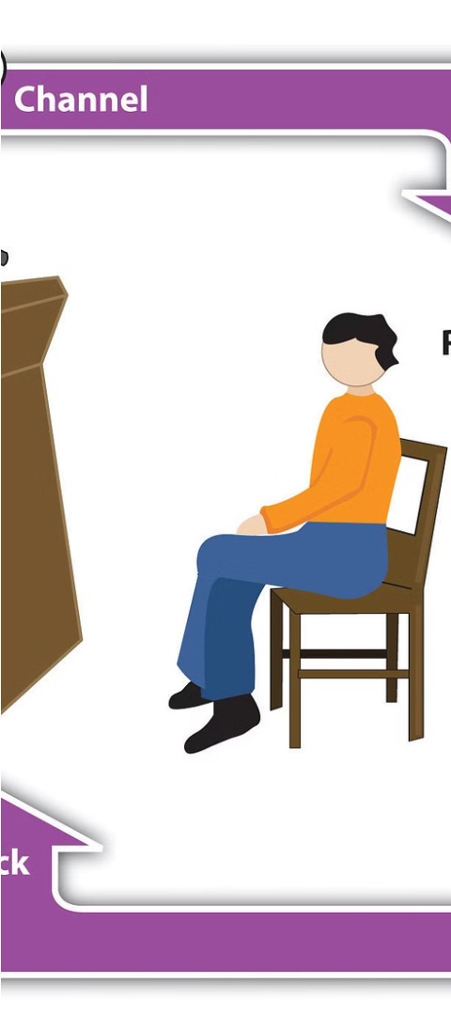



Engaging the Audience through Interaction
Encourage Participation
Invite the audience to ask questions, share their perspectives, or participate in activities.
Facilitate Discussion
Foster an engaging dialogue by responding to the audience's input and building upon their ideas.
Maintain Energy
Use dynamic body language, vocal variety, and enthusiasm to keep the audience engaged.

Slide 7
Handling Objections and Counterarguments
Anticipate Challenges
Acknowledge Concerns
Identify potential objections and counterarguments, and develop thoughtful responses in advance.
Address objections directly and empathetically, demonstrating your understanding of the audience's perspective.
Provide Balanced Responses
Remain Composed
Offer well-reasoned, fact-based rebuttals that strengthen your position while also respecting opposing views.
Maintain a calm and confident demeanor, even when faced with difficult questions or criticisms.

Slide 8
Conclusion and Key Takeaways
Establish Credibility
Appeal to Emotions
Provide Logical Arguments
Utilize Rhetorical Devices
Engage the Audience
Respond to Objections
Mastering the art of persuasive speeches requires a multifaceted approach. By applying these techniques, you can captivate your audience, effectively convey your message, and inspire them to action.

Slide 9
Literature:
Ballinger B. J., Brand J. D. Persuasive speaking: A review to enhance the educational experience //National Forensic Journal. – 1987. – Т. 5. – №. 1. – С. 49-54.
Romanova I. D., Smirnova I. V. Persuasive techniques in advertising //Training, language and culture. – 2019. – Т. 3. – №. 2. – С. 55-70.
Li L. The Analysis of Persuasion Techniques in Impromptu Speaking Contest. – 2024.
Li L. The Analysis of Persuasion Techniques in Impromptu Speaking Contest. – 2024.
Leon M. Persuasive Speeches //Public Speaking as Performance. – 2023.

