Slide 1


Sentence and Paragraph Construction: Mastering Cohesion and Coherence
Crafting effective sentences and paragraphs is the foundation of powerful written communication. In this workshop, we'll explore the principles of cohesion and coherence, equipping you with the skills to write with clarity, flow, and impact.
by By Dinara Naimanova,
M.Ed., senior lecturer of the Primary Education Department,
Faculty of Pedagogy and Psychology, Abai Kazakh National Pedagogical University.
Kazakhstan

Slide 2
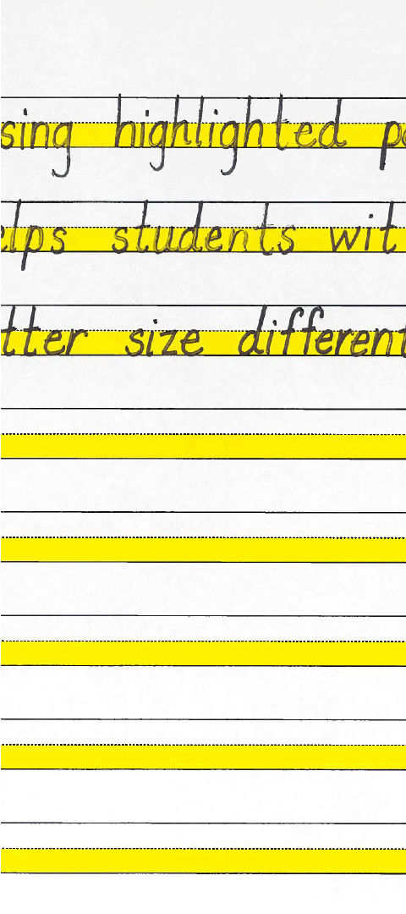
The Importance of Cohesion and Coherence
1
Cohesion
2
Coherence
Connecting ideas and creating a sense of flow through the strategic use of transition words, pronouns, and parallel structure.
Ensuring logical organization and alignment of ideas, with a clear and logical progression from one point to the next.
3
Benefits
Improved readability, enhanced understanding, and a more engaging and persuasive writing style.

Slide 3
Sentence Structure: Simple, Compound, and Complex
Simple Sentences
Compound Sentences
Complex Sentences
A single independent clause with a subject and a verb.
Two or more independent clauses joined by a coordinating conjunction.
An independent clause and one or more dependent clauses.

Slide 4
Paragraph Structure: The Essentials
Topic Sentence
1
Introduces the main idea of the paragraph and sets the stage for the supporting details.
2
Supporting Details
Provide evidence, examples, or explanations to support the main idea.
Concluding Sentence
3
Reinforces the main idea and transitions to the next paragraph.

Slide 5
Transition Words and Phrases for Cohesion
Sequence
Comparison
First, second, third, then, next, finally, in addition, moreover, furthermore.
Similarly, likewise, in contrast, on the other hand, however, yet, but.
Cause and Effect
Clarification
Because, since, as a result, consequently, therefore, thus.
In other words, that is, specifically, for example, for instance.

Slide 6




Interactive Activity: Sentence Combining
Short Sentences
Combine short sentences to create more complex and varied sentence structures.
Coordinating Conjunctions
Use conjunctions like "and," "but," and "or" to link independent clauses.
Subordinating Conjunctions
Incorporate dependent clauses using words like "because," "since," and "although."

Slide 7




Interactive Activity: Paragraph Reorganization
Reorder
Add Transitions
Eliminate Redundancy
Refine
Rearrange sentences within a paragraph to improve flow and coherence.
Incorporate transition words and phrases to strengthen connections between ideas.
Polish the paragraph by improving sentence structure and word choice.
Identify and remove unnecessary repetition to create a more concise paragraph.

Slide 8
Conclusion and Key Takeaways
Cohesion
Connecting ideas through transitions, pronouns, and parallel structure
Coherence
Ensuring logical organization and progression of ideas
Sentence Structure
Mastering simple, compound, and complex sentences
Paragraph Structure
Topic sentence, supporting details, and concluding sentence
Interactive Activities
Sentence combining and paragraph reorganization

Slide 9
Literature:
Faradhibah R. N., Nur N. A. Analyzing students’ difficulties in maintaining their coherence and cohesion in writing process //ETERNAL (English, Teaching, Learning, and Research Journal, 183-194. – 2017.
Tardy C. M., Swales J. M. Form, text organization, genre, coherence, and cohesion //Handbook of research on writing. – Routledge, 2009. – С. 693-713.
Sidabutar U. An analysis of lexical cohesion on the students’ writing //JETAL: Journal of English Teaching & Applied Linguistic. – 2021. – Т. 2. – №. 2. – С. 62-67.
Amperawaty A., Warsono W. The use of cohesive devices to achieve coherence in the background section of the students' formal writing //English Education Journal. – 2019. – Т. 9. – №. 1. – С. 34-40.
Abata Checa F. M. Cohesion and Coherence in Academic Writing Skill : дис. – Ecuador: Latacunga: Universidad Técnica de Cotopaxi (UTC), 2021.

