Slide 1


Improving Pronunciation and Intonation for Clear Speech
This workshop will provide you with practical techniques to improve your pronunciation and intonation, empowering you to communicate more clearly and confidently. We'll focus on addressing common challenges with tricky sounds and engaging in interactive exercises to master the foundations of clear speech.
by By Dinara Naimanova,
M.Ed., senior lecturer of the Primary Education Department,
Faculty of Pedagogy and Psychology, Abai Kazakh National Pedagogical University.
Kazakhstan

Slide 2

Common Challenges with Difficult Sounds
1
Consonant Clusters
2
Vowel Sounds
Words with multiple consonants like "strength" and "rhythm" can be tricky to pronounce clearly.
Distinguishing between similar vowel sounds like "sheep" and "ship" is essential for intelligible speech.
3
Intonation Patterns
Mastering the rise and fall of your voice can make a big difference in how your message is perceived.

Slide 3
Interactive Activity: Tongue Twisters
Peter Piper
She Sells Seashells
Try reciting this classic tongue twister focusing on the "p" and "r" sounds.
Challenge yourself to say this quickly while maintaining clear "s" and "sh" sounds.
How Much Wood
Unique New York
Concentrate on the "w" and "d" sounds in this playful tongue twister.
Practice differentiating the "y" and "n" sounds in this tricky phrase.

Slide 4

Principles of Clear Pronunciation
Articulation
Connected Speech
Focus on moving your lips, tongue, and jaw to produce each sound clearly.
Practice linking words together smoothly without excessive pauses.
1
2
3
Rhythm and Stress
Pay attention to the natural rhythm and emphasis of words and phrases.

Slide 5
Exercises for Vowel Sounds
Short Vowels
Long Vowels
Diphthongs
Focus on crisp, distinct pronunciations of short vowel sounds like "a," "e," "i," "o," and "u."
Practice elongating long vowel sounds like "a," "e," "i," "o," and "u."
Smoothly transition between two vowel sounds like "oy," "ow," and "ew."
Bake, beet, bite, boat, boot
Toy, how, new
Bat, bet, bit, bot, but
Cane, feet, kite, dome, tune
Coin, cloud, grew
Cat, pen, pin, pot, cut
Soil, down, few
Mat, bed, lid, rod, hut
Fade, team, hive, hope, cube

Slide 6




Interactive Activity: Minimal Pair Practice
Ship
Sheep
Bath
Bet
vs.
Distinguish between the "i" and "ee" sounds.
vs.
Contrast the "a" and "e" sounds.

Slide 7




Mastering Intonation and Stress
Rising Intonation
Use for asking questions or expressing uncertainty.
Falling Intonation
Convey statements, commands, or concluding thoughts.
Stress Patterns
Emphasize key words to highlight important information.

Slide 8
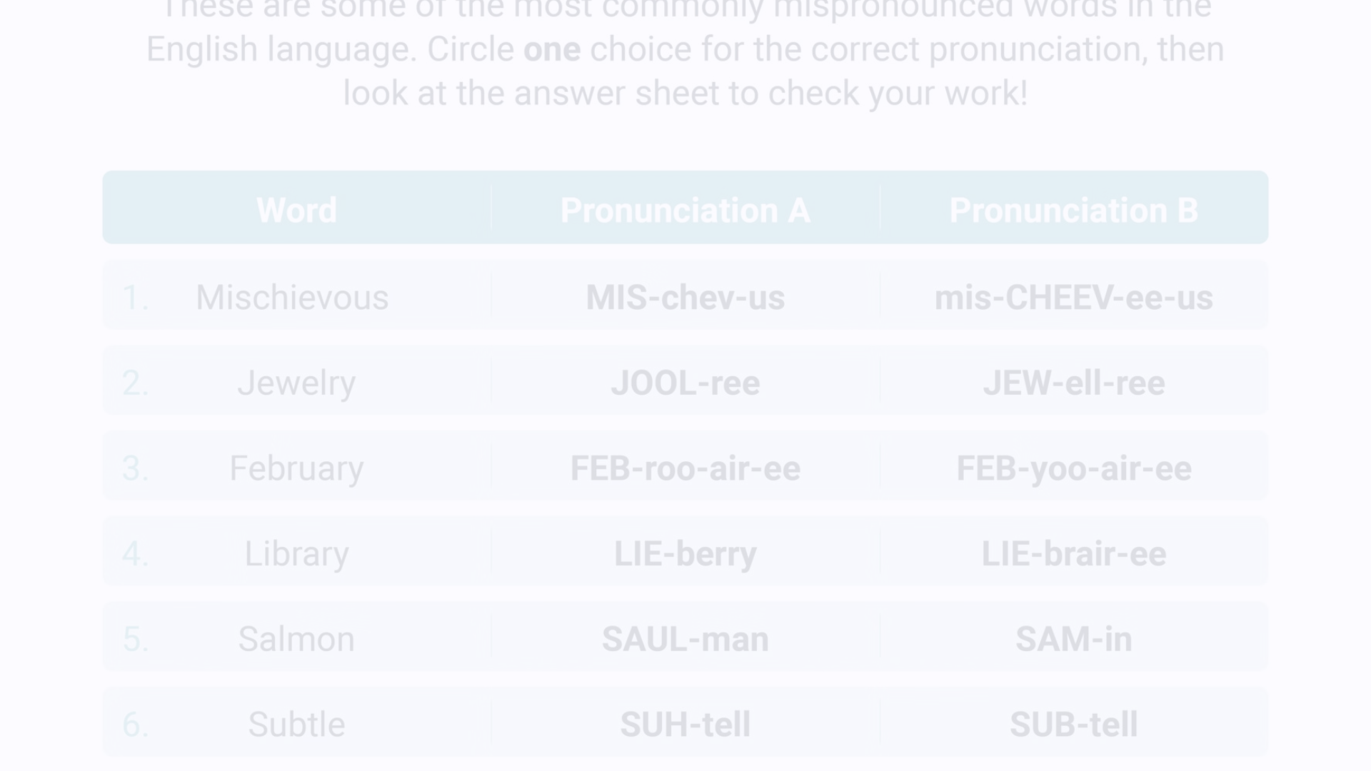
Conclusion and Next Steps
By applying the techniques covered in this workshop, you'll be well on your way to improving your pronunciation and intonation for clearer, more confident communication. Keep practicing, seek feedback, and continue exploring resources to further develop your English skills.

Slide 9
Literature:
La Fein R. Clear Speech: Pronunciation and Listening Comprehension in North American English. – 1993.
Levis J. M., Grant L. Integrating pronunciation into ESL/EFL classrooms //Tesol Journal. – 2003. – Т. 12. – №. 2. – С. 13-19.
Smakman D. Clear English Pronunciation: A Practical Guide. – Routledge, 2019.
Chela-Flores B. Pronunciation and language learning: An integrative approach. – 2001.
Levis J., Pickering L. Teaching intonation in discourse using speech visualization technology //System. – 2004. – Т. 32. – №. 4. – С. 505-524.

