Slide 1

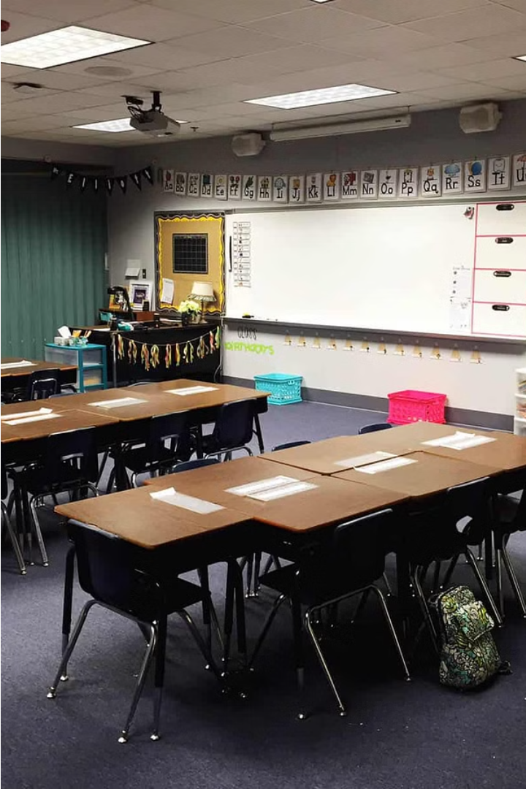
Review of Basic English Grammar Rules
This workshop will provide a comprehensive review of the fundamental grammar rules in the English language, helping you identify and correct common mistakes. Through interactive activities, you will improve your writing and communication skills.
By Dinara Naimanova,
M.Ed., senior lecturer of the Primary Education Department,
Faculty of Pedagogy and Psychology, Abai Kazakh National Pedagogical University.
Kazakhstan

Slide 2
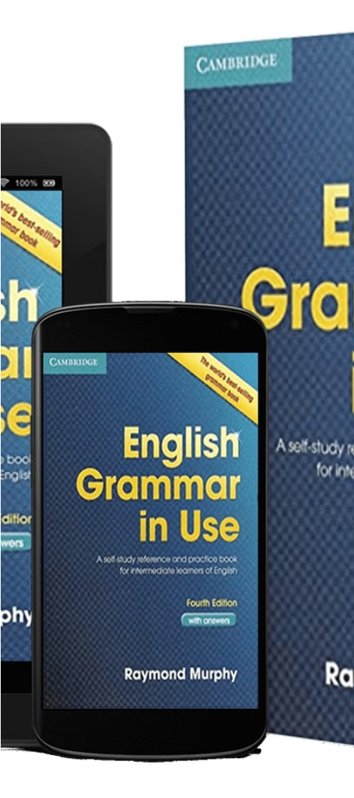
Review of Basic English Grammar Rules
1
Parts of Speech
2
Sentence Structure
Understand the different parts of speech, including nouns, verbs, adjectives, adverbs, prepositions, and conjunctions, and how they function in a sentence.
Learn the basic structure of a complete sentence, including subject, verb, and object, and how to construct clear, well-formed sentences.
3
Punctuation Rules
Review the proper use of punctuation marks, such as periods, commas, apostrophes, and quotation marks, to enhance the clarity and flow of your writing.

Slide 3
Common Grammatical Errors to Avoid
Subject-Verb Agreement
Pronoun Usage
Verb Tenses
Use pronouns (such as he, she, it, they) correctly, ensuring they agree with the noun they are referring to.
Maintain consistent verb tenses throughout a sentence or paragraph to avoid confusion.
Ensure that the subject and verb of a sentence agree in number (singular or plural).

Slide 4
Interactive Activity: Identifying Grammatical Errors
Sentence 1
Sentence 2
The dog's barked loudly in the backyard.
Her worried about the upcoming exam.
Sentence 3
Sentence 4
The team is planning a celebration after they won the championship.
The book that I read yesterday were very interesting.

Slide 5




Interactive Activity: Correcting Grammatical Errors
Sentence 1
The dogs barked loudly in the backyard.
Sentence 2
She was worried about the upcoming exam.
Sentence 3
The team was planning a celebration after they won the championship.
Sentence 4
The book that I read yesterday was very interesting.

Slide 6
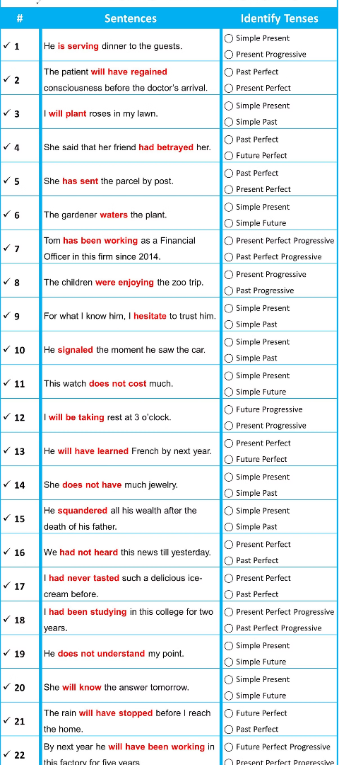
Strategies for Improving Grammar Skills
1
Read Extensively
Read a variety of high-quality literature to expose yourself to proper grammar usage in context.
2
Practice Writing
Engage in regular writing exercises to reinforce your understanding and application of grammar rules.
3
Utilize Resources
Refer to grammar handbooks, online resources, and feedback from others to identify and address your weaknesses.

Slide 7



Applying Grammar Rules in Writing
Nouns
Verbs
Punctuation
Identify and use nouns correctly, ensuring proper capitalization and agreement with verbs.
Choose the appropriate verb tense and form to convey your intended meaning accurately.
Incorporate punctuation marks correctly to enhance the clarity and flow of your writing.

Slide 8
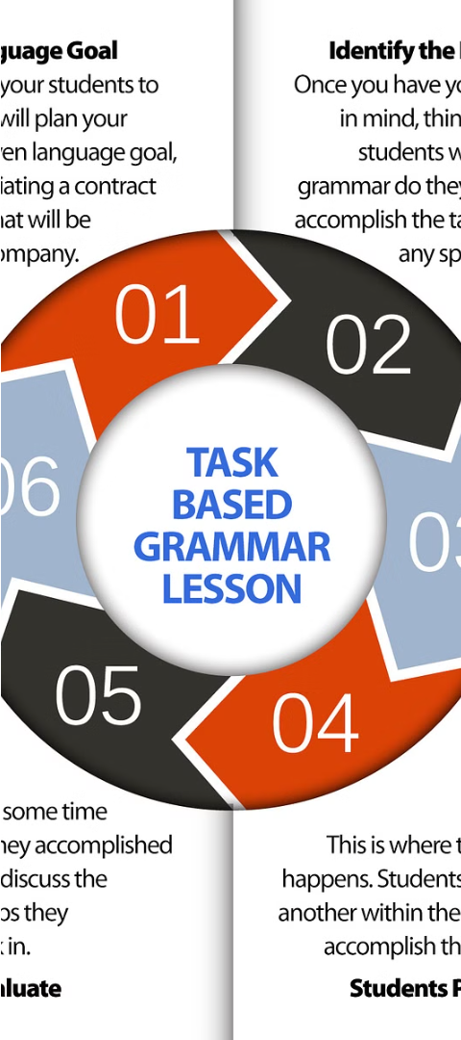
Conclusion and Key Takeaways
1
Mastering Fundamentals
2
Consistent Practice
Develop a strong understanding of the basic grammar rules to improve your overall communication skills.
Regularly apply grammar principles through writing exercises to reinforce your learning.
3
Continuous Improvement
Identify your weaknesses and seek out resources to continuously enhance your grammar proficiency.

Slide 9
Literature:
Nelson G., Greenbaum S. An introduction to English grammar. – Routledge, 2018.
Ogden C. K. Basic English: A general introduction with rules and grammar. – 1930.
Nelson G., Greenbaum S. An introduction to English grammar. – Routledge, 2018.
McCarthy M. English grammar: the basics. – Routledge, 2021.
Yule G. Explaining English Grammar: A Guide to Explaining Grammar for Teachers of English as a Second Or Foreign Language. – Oxford University Press, 1998.

