Slide 1


Introduction to English Language Oral and Written Speech Workshop
This workshop is designed to equip participants with the essential skills for effective oral and written communication in the English language. By the end of this course, you will be able to express yourself clearly, confidently, and with impact.
By Dinara Naimanova,
M.Ed., senior lecturer of the Primary Education Department,
Faculty of Pedagogy and Psychology, Abai Kazakh National Pedagogical University.
Kazakhstan

Slide 2
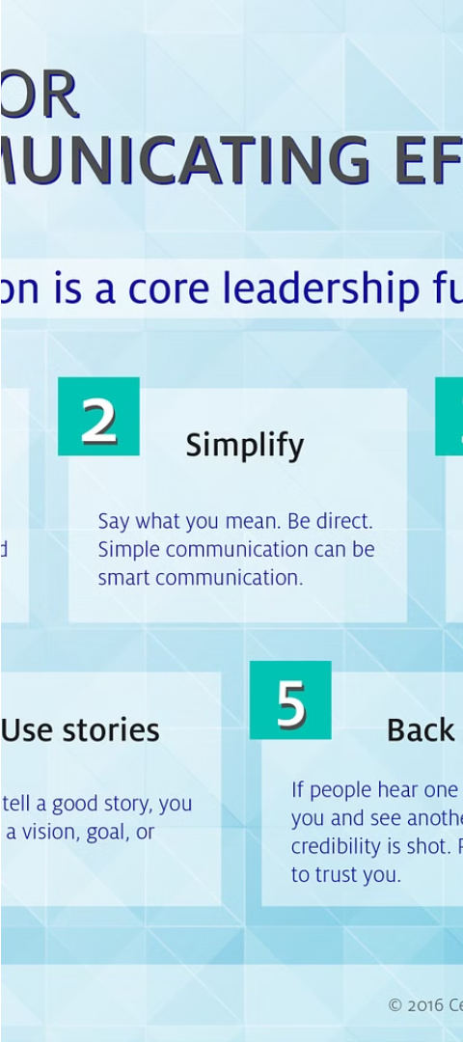
Purpose of the Discipline
1
Enhance Oral Fluency
2
Improve Written Expression
Develop the ability to speak English clearly, coherently, and with confidence in various settings.
Master the techniques for crafting compelling, well-structured written documents.
3
Effective Presentation Skills
Learn how to effectively engage an audience and deliver impactful presentations.

Slide 3
Course Overview
Unit 1: Fundamentals
Unit 2: Oral Communication
Unit 3: Written Expression
Explore the core principles of effective communication, including active listening, rhetorical strategies, and language mechanics.
Develop public speaking abilities, interpersonal communication skills, and techniques for delivering engaging presentations.
Master the art of crafting clear, concise, and persuasive written documents, such as reports, essays, and business correspondence.

Slide 4
Goals of the Discipline
Cultivate Confidence
Foster Clarity
Empower participants to communicate with self-assurance in personal and professional settings.
Teach techniques for organizing thoughts and expressing ideas in a clear, logical manner.
Enhance Expressiveness
Improve Persuasiveness
Develop the ability to convey emotions, nuances, and subtleties through language.
Equip participants with the skills to effectively influence and persuade their audience.

Slide 5

Developing Effective Oral Communication Skills
1
Vocal Delivery
Focus on improving volume, tone, pace, and articulation to engage the audience.
2
Body Language
Learn how to use gestures, eye contact, and posture to enhance the delivery of your message.
3
Audience Interaction
Develop techniques to actively involve the audience and respond to their needs and feedback.

Slide 6




Improving Written Communication Abilities
Structure
Style
Grammar
Revision
Organize ideas in a clear, logical, and coherent manner.
Cultivate a professional, concise, and engaging writing style.
Ensure proper use of grammar, punctuation, and spelling.
Develop the habit of proofreading and editing to refine written work.

Slide 7
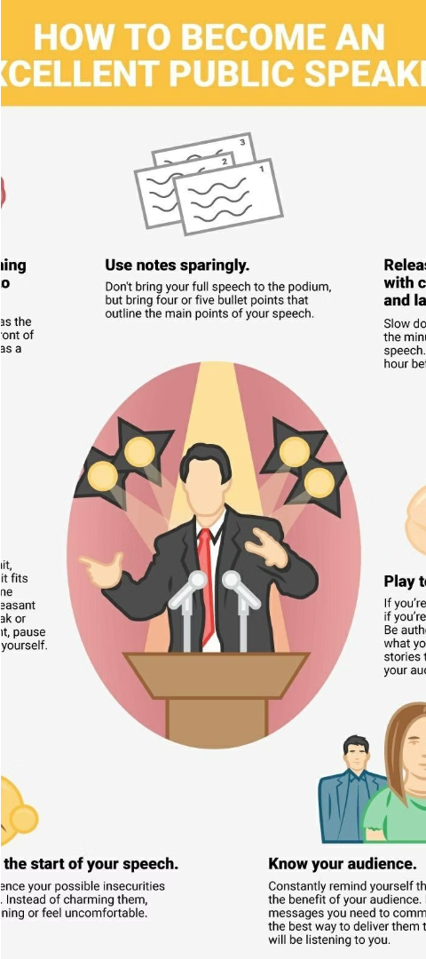



Strategies for Enhancing Presentation Skills
Preparation
Thoroughly research the topic, organize the content, and anticipate audience needs.
Delivery
Focus on confident body language, clear articulation, and engaging the audience.
Visual Aids
Use visual aids strategically to enhance understanding and visual appeal.

Slide 8
Practical Applications and Workshops
Individual Presentations
Participants will deliver short presentations on assigned topics to practice their skills.
Group Discussions
Engage in collaborative discussions and debates to develop interpersonal communication abilities.
Written Assignments
Complete a range of written exercises, such as reports, emails, and creative writing pieces.
Peer Feedback
Provide constructive feedback to classmates to foster a supportive learning environment.

Slide 9

Understanding the Importance of Communication Skills
Communication skills are essential for success in the workplace and in life. Effective communication allows us to express our ideas clearly, collaborate with others, and build strong professional relationships.

Slide 10
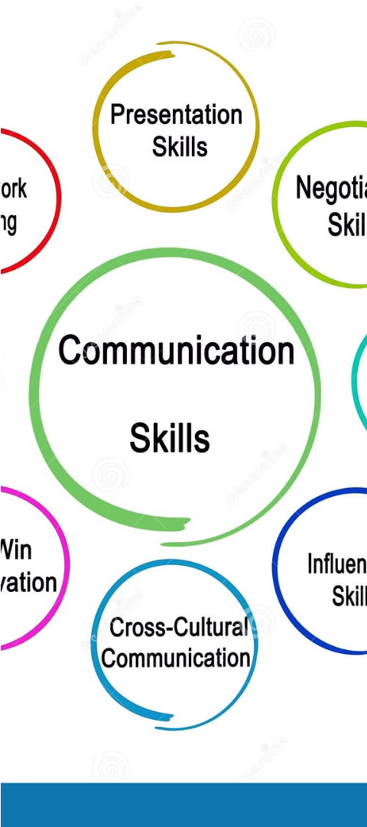
Defining Communication Skills
1
Verbal Communication
2
Nonverbal Communication
Includes speaking clearly, articulating thoughts, and active listening.
Body language, eye contact, and tone of voice convey meaning.
3
Written Communication
Emails, reports, and presentations that are clear and concise.

Slide 11
Importance of Communication in the Workplace
Collaboration
Problem-Solving
Productivity
Effective communication enables teams to work together efficiently and achieve goals.
Clearly expressing ideas and listening to others leads to better solutions.
Strong communication skills reduce misunderstandings and streamline workflows.

Slide 12
Barriers to Effective Communication
Cultural Differences
Technological Challenges
Varied backgrounds and experiences can lead to misunderstandings.
Remote work and virtual meetings increase opportunities for miscommunication.
Emotional Biases
Lack of Clarity
Personal emotions can cloud objectivity and make it difficult to listen effectively.
Unclear or ambiguous messages prevent the receiver from understanding the intended meaning.

Slide 13

Setting SMART Goals for the Workshop
1
Specific
Identify concrete communication skills you want to improve, such as public speaking or active listening.
2
Measurable
Determine how you will track your progress, such as receiving feedback from colleagues.
3
Achievable
Set goals that challenge you but are still within your reach to build confidence.

Slide 14
Improving Listening Skills
1
Pay Attention
2
Ask Questions
Avoid distractions and focus on the speaker's words and body language.
Seek clarification and demonstrate that you are engaged in the conversation.
3
Paraphrase
4
Empathize
Restate the key points to ensure you have understood the message correctly.
Try to understand the speaker's perspective and emotions behind their words.

Slide 15
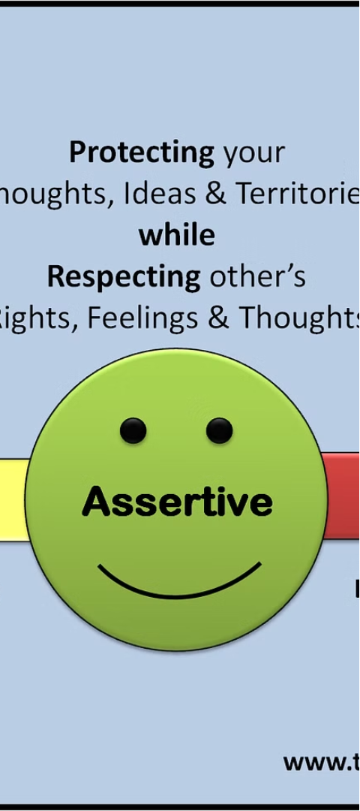



Developing Assertiveness
Express Needs
Clearly communicate your thoughts, feelings, and requirements without aggression.
Stand Your Ground
Maintain confidence in your position while remaining open to compromise.
Advocate for Yourself
Promote your ideas and achievements without being boastful or demanding.

Slide 16



Conclusion and Next Steps
Practice
Seek Feedback
Utilize Resources
Continuously apply your communication skills in various situations.
Ask groupmates and mentors for constructive input to improve.
Explore workshops, books, and online courses to further develop your skills.

Slide 17
Literature:
Hughes R. English in speech and writing: Investigating language and literature. – Routledge, 2005.
Blake N. F. Speech and writing: an historical overview //The Yearbook of English Studies. – 1995. – Т. 25. – С. 6-21.
Finegan D. B. E. The linguistic evolution of five written and speech-based English genres from the 17th to the 20th centuries
//Topics in English Linguistics 10. – 1992. – С. 688.
4. Jumanbaevna A. M. Development of oral and written speech in the study of the Russian language in an agrarian university
//ACADEMICIA: An International Multidisciplinary Research Journal. – 2021. – Т. 11. – №. 3. – С. 1743-1747.
5. Akinnaso F. N. On the differences between spoken and written language //Language and speech. – 1982. – Т. 25. – №. 2. – С. 97-125.

